Slide 1
Rotor Hub And Pitch System
Group Members :
Dhruvin Kakdiya
Adharsh Pappinisseri Veedu
Muthu Thirunavukarasu
Syed Mohammed Sikandar
Week number : 07
Date: 12/11/2025
Supervisor: Prof. Peter Quell

Slide 2
List of contents
Calculation & initial design of Pitch bearing
CAD model of Pitch Bearing
Backup supply system
Muthu Thirunavukarasu

Slide 3
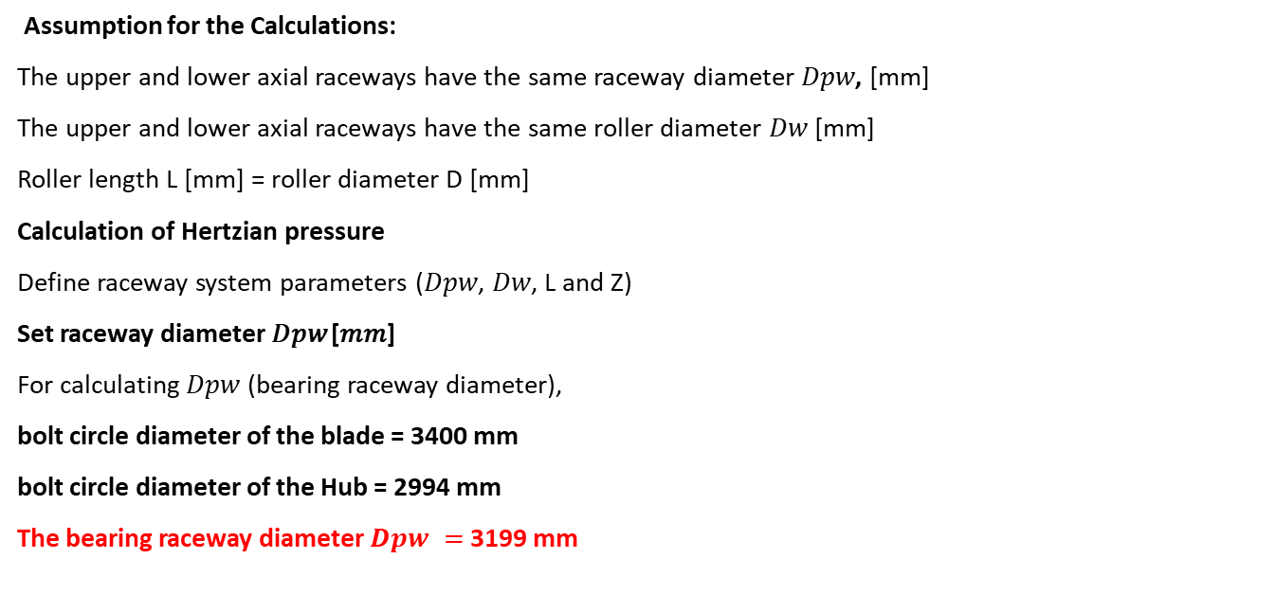
Dimensioning of the Three row roller bearing
Assumption for the Calculations:
The upper and lower axial raceways have the same raceway diameter 𝐷𝑝𝑤, [mm]
The upper and lower axial raceways have the same roller diameter 𝐷𝑤 [mm]
Roller length L [mm] = roller diameter D [mm]
Calculation of Hertzian pressure
Define raceway system parameters (𝐷𝑝𝑤, 𝐷𝑤, L and Z)
Set raceway diameter 𝐷𝑝𝑤 [𝑚𝑚]
For calculating 𝐷𝑝𝑤 (bearing raceway diameter),
bolt circle diameter of the blade = 3400 mm
bolt circle diameter of the Hub = 2994 mm
The bearing raceway diameter $Dpw =$3199 mm

Slide 4
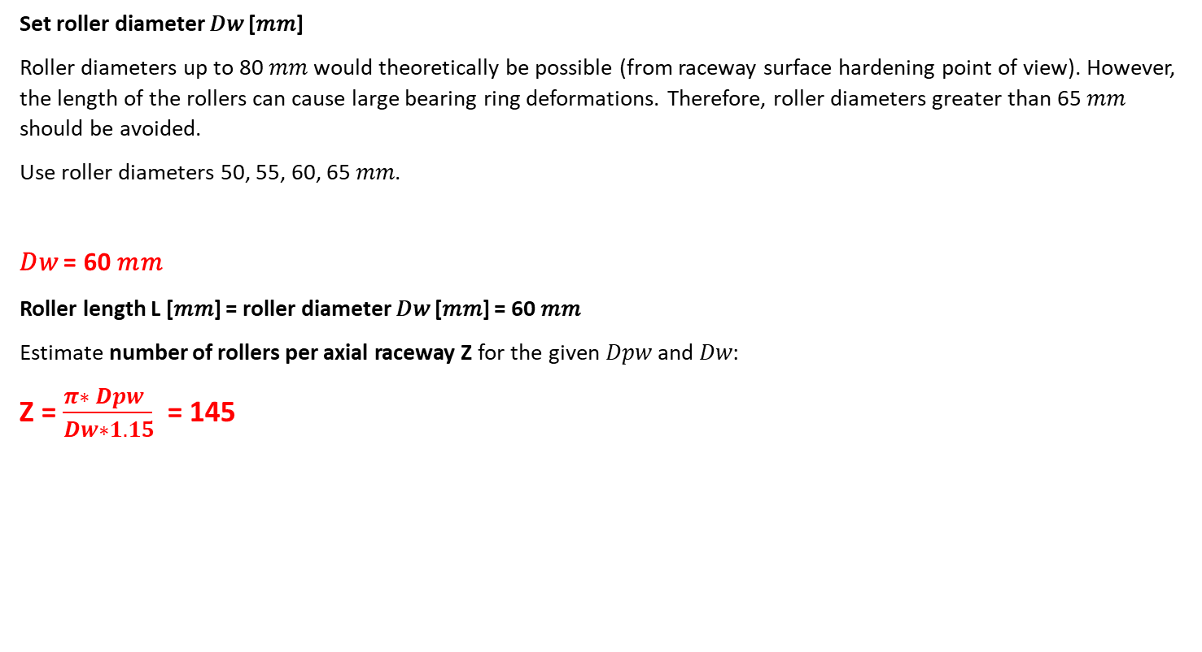
Set roller diameter 𝐷𝑤 [𝑚𝑚]
Roller diameters up to 80 𝑚𝑚 would theoretically be possible (from raceway surface hardening point of view). However, the length of the rollers can cause large bearing ring deformations. Therefore, roller diameters greater than 65 𝑚𝑚 should be avoided.
Use roller diameters 50, 55, 60, 65 𝑚𝑚.
𝐷𝑤 = 60 𝑚𝑚
Roller length L [𝑚𝑚] = roller diameter 𝐷𝑤 [𝑚𝑚] = 60 𝑚𝑚
Estimate number of rollers per axial raceway Z for the given 𝐷𝑝𝑤 and 𝐷𝑤:
Z = $\frac{π∗ Dpw }{Dw∗1.15}$ = 145

Slide 5
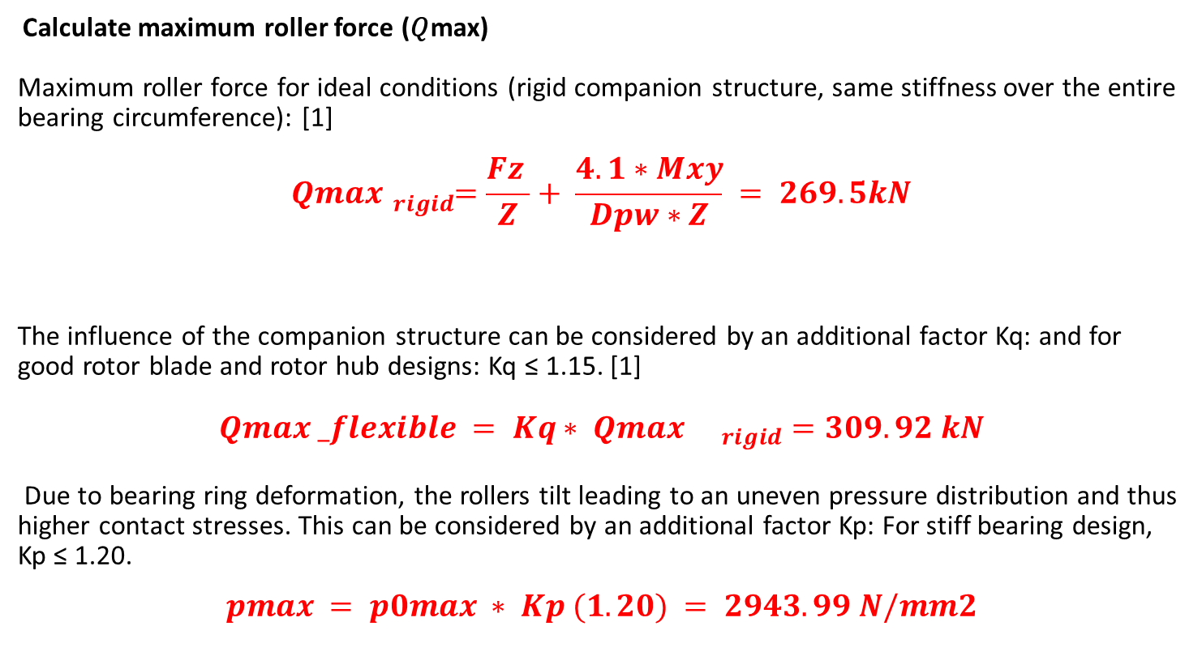
Calculate maximum roller force (𝑄max)
Maximum roller force for ideal conditions (rigid companion structure, same stiffness over the entire bearing circumference): [1]
$$Qmax{}_{rigid}^{}=\frac{Fz }{Z}+ \frac{4.1∗Mxy}{Dpw∗Z} = 269.5kN$$
The influence of the companion structure can be considered by an additional factor Kq: and for good rotor blade and rotor hub designs: Kq ≤ 1.15. [1]
$$Qmax _flexible = Kq∗ Qmax {}_{rigid}^{}=309.92 kN$$
Due to bearing ring deformation, the rollers tilt leading to an uneven pressure distribution and thus higher contact stresses. This can be considered by an additional factor Kp: For stiff bearing design, Kp ≤ 1.20.
$$pmax = p0max ∗ Kp (1.20) = 2943.99 N/mm2$$

Slide 6
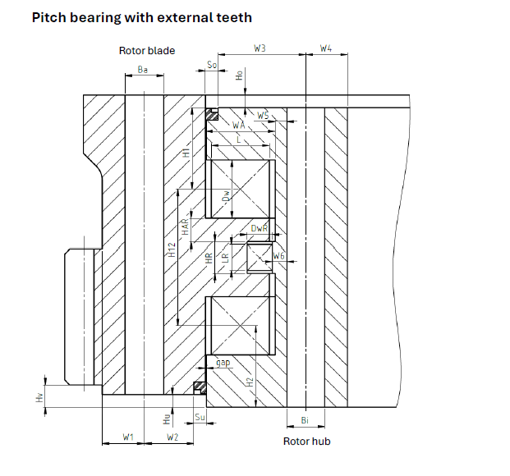
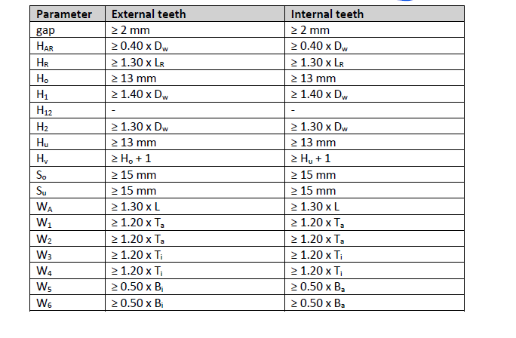
CAD model of Pitch Bearing
Bearing Raceway Diameter 3199 mm
Outer BCD 3400 mm
Inner BCD 2994 mm

Slide 7
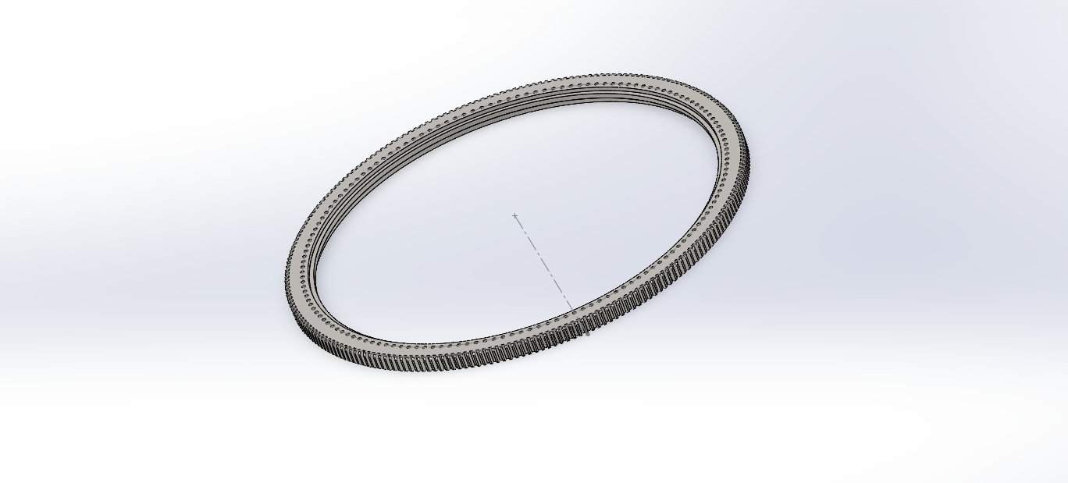
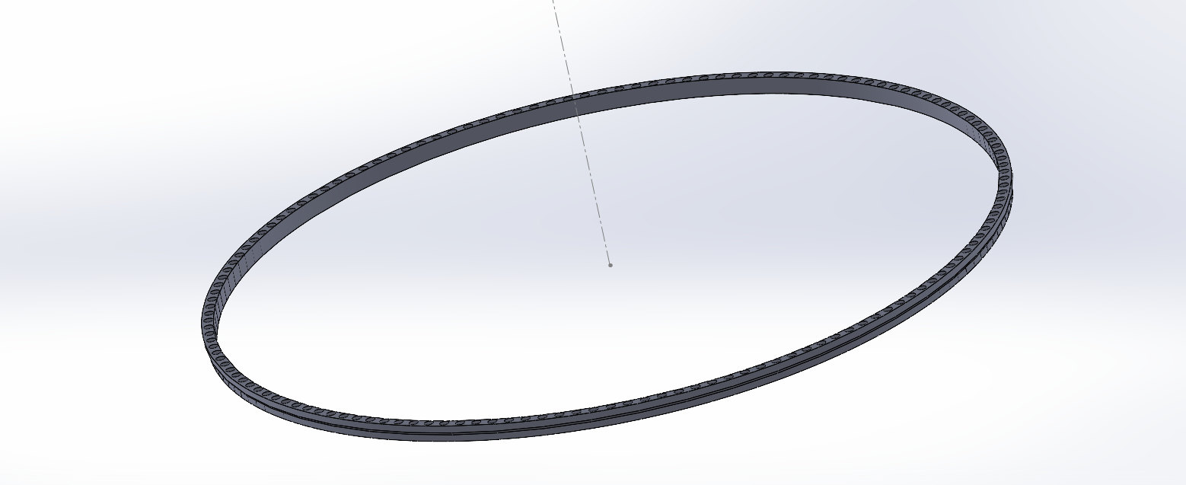
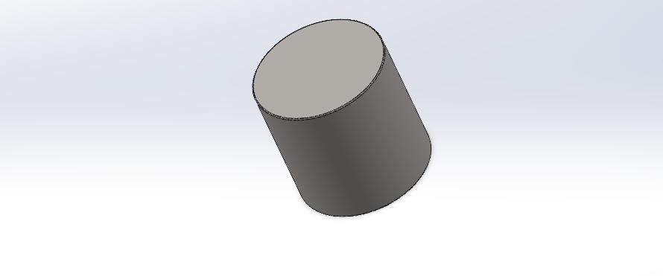
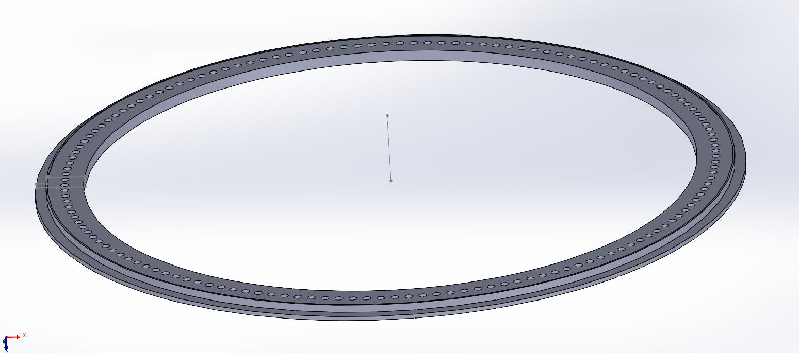
CAD model of Pitch Bearing
GEAR RING.
INNER RING.
OUTER RING.
ROLLER 60 mm DIAMETER
Muthu

Slide 8
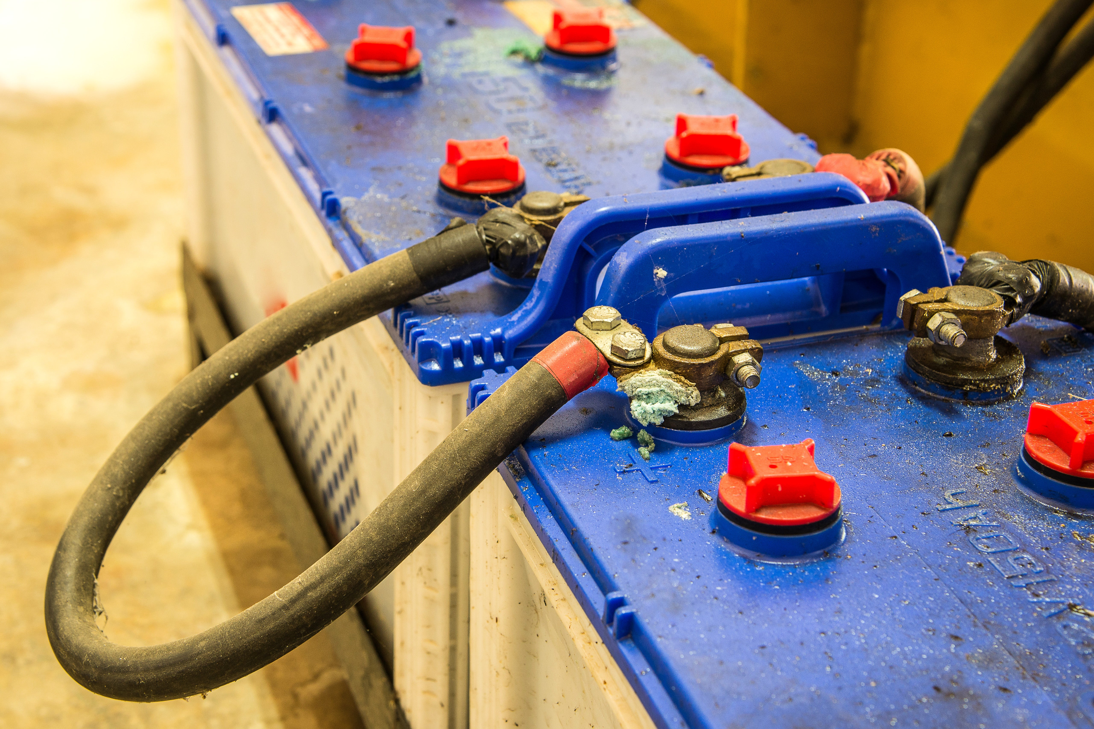
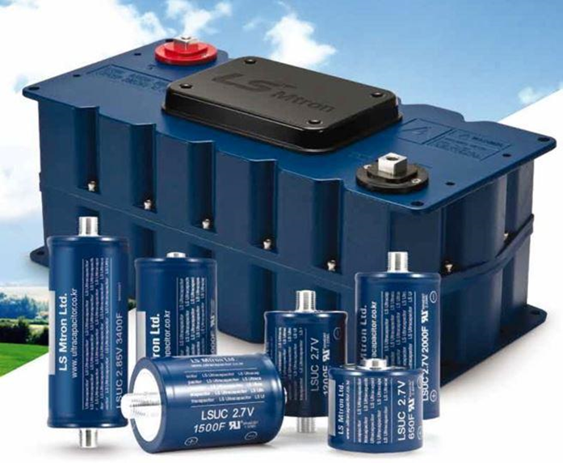
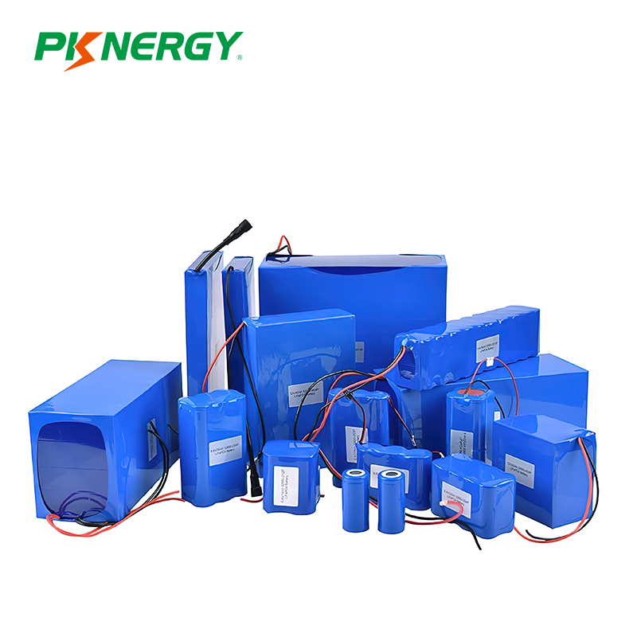
Back up supply system
Parameter | Lead Acid Batteries | Super capacitors | Lithium batteries
Nominal cell voltage | 2.0 V | 2.5 V – 2.7 V | 3.2–3.7 V
Energy density (Wh kg⁻¹) | 30–50 | 5–10 | 120–250
Power density (W kg⁻¹) | 180–400 | 5,000–10,000 | 250–2,000
Cycle Life | 300–500 | >1,000,000 | 2,000–7,000
Operating temparature | −10 °C - +45 °C | −40 °C - +65 °C | −20 °C - +55 °C
Maintenance | High | Minimal | Low
Muthu Thirunavukarasu

Slide 9
Energy required for the motor side
[4]
From the 3 phase Ac electrical formula
Assumptions & Estimations
The calculations focus on Single Axis Calculations: calculations for one axis and could be scaled appropriately if needed.
Emergency Stop: the emergency stop system should allow for a single full cycle of pitching from 0° to 90° to ensure safety and functionality.
Cycle 1: Emergency stop, pitching the blade from 0° to 90°.
Cycle 2: Repositioning the blade back to 0° for safety or maintenance.
√3 ⋅U N⋅I max ⋅t ⋅PF
Muthu Thirunavukarasu

Slide 10
From our Motor specifications
U N : Nominal motor voltage (V) = 400
I max : Maximum motor current (A) = 47 A
PF: Power Factor = 0.85
𝑡: Time based on pitch rate ( 4°/s) = [180 (deg) / 4 (deg/sec) ] ⋅2 = 90 sec
We divide by 3600 to convert Joules (J) into Watt-hours (Wh)
E = 2490,96. 24 J
E = 691.93 Wh
Muthu Thirunavukarasu

Slide 11
We add a 30% safety margin because the calculated energy is ideal. In reality, battery aging, temperature, inverter losses, and emergency loads require extra energy.
=691.93×(1+30/100)
E = 900 Wh

Slide 12
Reasons to choose Lithium ion batteries
For a wind-energy system requiring moderate energy storage and frequent cycling, lithium-ion technology provides the best compromise between energy density, cost, safety, and lifetime.
Lead-acid systems would degrade quickly under deep-cycle operation.
Supercapacitors cannot store sufficient energy for hours-scale buffering
Lithium-ion batteries—particularly LiFePO₄ (LFP) and Lithium-titanate (LTO) chemistries—offer high round-trip efficiency (90–95 %), long service life (3,000–20,000 cycles), and excellent temperature stability
Muthu Thirunavukarasu

Slide 13
Compariosn of Lithium titanate (Li₄Ti₅O₁₂) & Lithium iron phosphate (LiFePO₄)
Parameter | Lithium Phosphate | Lithium titanate
Energy density | 120–160 Wh/kg | 60–90 Wh/kg
Operating temparature | –20°C to +60°C | –40°C to +60°C
Safety | Excellent | Outstanding
Cycle life | 2000 – 5000 cycles | 10,000–20,000 cycles
Maintenance | Very low | Very low
Cost | Moderate | High
Voltage profile | Stable, high energy | Very stable, low voltage
Charge/discharge rate | Up to 3C | Up to 10C
Efficiency | 90 % – 95 % | 85 % - 90 %
Muthu Thirunavukarasu

Slide 14
Reasons for choosing Lithium titanate (Li₄Ti₅O₁₂)
Long Cycle life ( over 15,000 cycles)
Supports high charge and discharge rates.
Though more expensive initially, it ensures long-term cost efficiency and reliability
We will seek further guidance from our professor to help validate this choice and ensure the technical objectives
Muthu Thirunavukarasu

Slide 15
Bibliography
1. Nitta, N., Wu, F., Lee, J. T., & Yushin, G. (2015). Li-ion battery materials: present and future. Materials Today [ 8.11.25]
2. Scrosati, B., & Garche, J. (2010). Lithium batteries: Status, prospects and future. Journal of power sources [8.11.25]
3. NREL. (2021). Energy storage Technology overview National Renewable Energy Laboratory. [9.11.25]
4. Optimus Shakti’s Calculation report
5. Ramadass, P., et al. (2017). Review on Lithium Titanate (LTO) batteries. Journal of Electro chemical energy and storage. [8.11.25]
6. https://www.pknergybattery.com
7. https://docs.nrel.gov/docs/fy24osti/89161.pdf (9.11.2025)
8. Mr.christian Bulligk, Three Rows roller bearing Dimensioning of the Raceway system & Loads, Flensburg, 2024 (9.11.2025)

